Slide 1
SCC211 Operation System
(Introduction to Concurrency)
Zhang Jinyu – zjy@bjtu.edu.cn
School of Computer and Information Technology
SD408

Slide 2
Objectives
Concurrency is every day life
Concurrency in computing
Processes, programs, and processors
Java threads
Concurrency vs. parallelism

Slide 3

Concurrency in the Real World

Slide 4

The Real World - Restrooms
How to guarantee one person at a time?
Locked door stops other people from entering when occupied.

Slide 5

How to keep kitchen stocked with food?
Solution
Rules
Keep cupboard always stocked;
Leave sticky note when out buying
stocked; Leave sticky note when out buying
Write note if there is no food in kitchen; Write note if gone out to purchase food

Slide 6
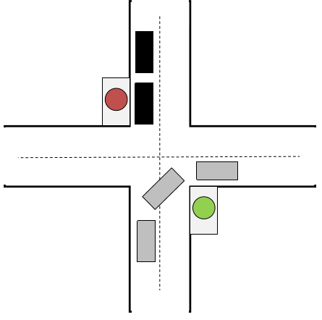
How to avoid collisions at traffic intersections?
Solution
Rules
Display traffic direction (traffic lights)
Don’t move if light is red/amber
From red->green, wait for all cars to first exit

Slide 7
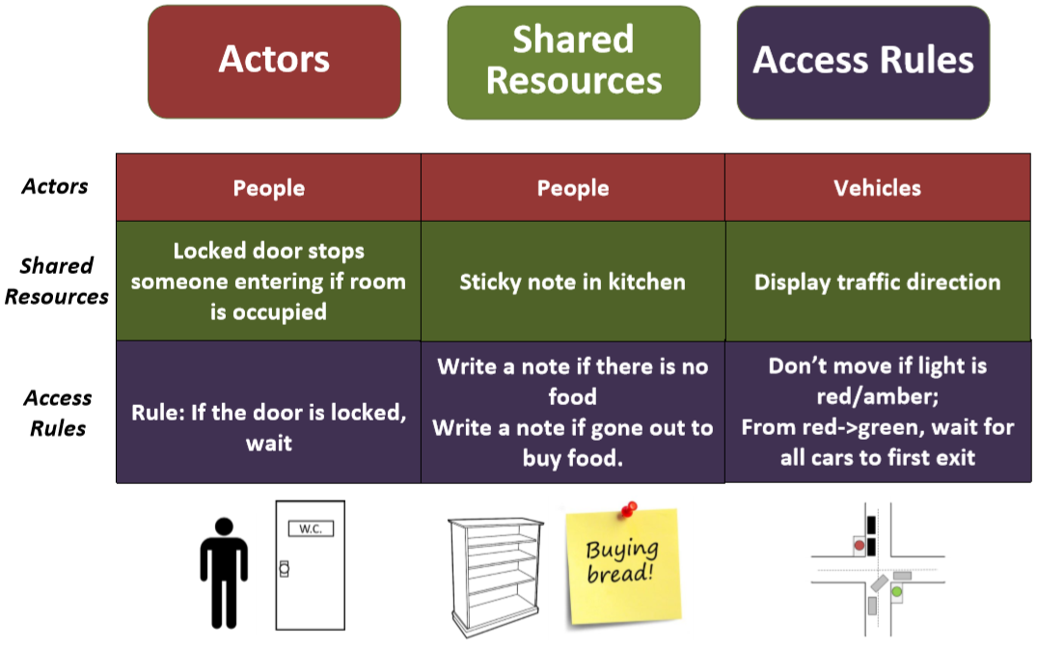
Concurrency Components

Slide 8
In Computer Systems…
Multiple actors (processes) inside an OS
One or more threads in a single process
Thread: smallest sequence of instructions managed independently by scheduler
Scheduler: method for how work is assigned to resources to complete work
Shared resources
Memory (global, heap)
Hardware devices

Slide 9

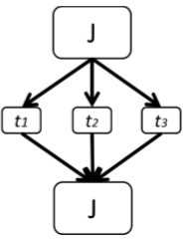
Examples
Producer-consumer
(must share/access same data)
Parallel Execution
(Data shared across threads)

Slide 10
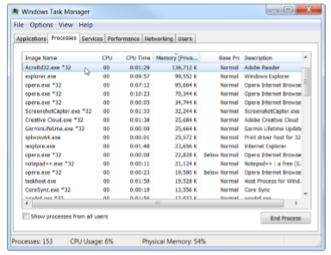
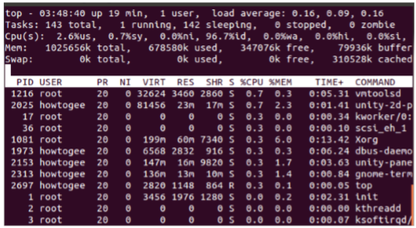
Concurrency: Definition
How multiple, independently controlled processes behave when running and interacting with each other.

Slide 11
Different definitions
并发定义
“…the decomposability property of a program, algorithm, or problem into order-independent or partially-ordered components or units.”
“…even if the concurrent units of the program, algorithm, or problem are executed out-of-order or in partial order, the final outcome will remain the same.”

Slide 12
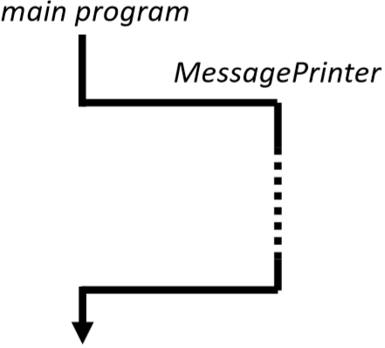
Java threads
Consider a MessagePrinter class with method print_string() that prints a string in a window
Conventionally, calling program waits “a long time” for print operation completion before able to continue…

Slide 13
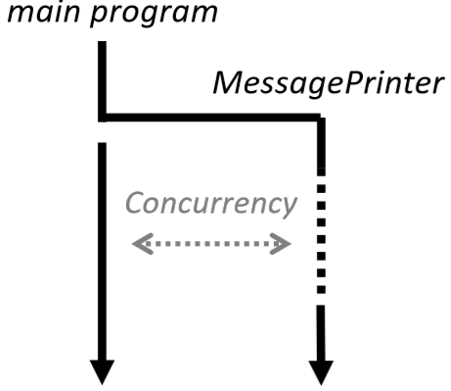
Java threads
Can use a thread in MessagePrinter object
Allow calling program to continue “immediately”

Slide 14
Java Threads
//Instantiate MessagePrinter object for the message MessagePrinter mp = new MessagePrinter(“Hello world”);
//create a new thread for the MessagePrinter Thread t = new Thread(mp);
//Start thread t.start();
// … do other useful things while message prints

Slide 15
Java Threads
Before showing the MessagePrinter class… Java interfaces review
Interface similar to classes: method signatures with no method bodies (implementations)
Implementing an interface is like extending a class
Must provide an implementation of all method signatures in the interface

Slide 16
Thread creation in Java (implement interface)
1) Define a class that implements java.lang.Runnable – java.lang.Runnable is an interface – Which has one method signature to implement: public void run();
2) Create an object of class Thread by passing an object of Runnable class to Thread constructor

Slide 17
MessagePrinterclass
public class MesssagePrinter implements Runnable
{
String message;
public MessagePrinter(String m) { message = m; }
public void run()
{
TextArea text = new TextArea(...);
appendText(message); // The thread’s work is now complete.
}
}

Slide 18
Summary: Three steps to thread creation in Java
Step 1:
Define class R which implements Runnable
Create your objects
Make an instance of class R
Make a thread instance by passing instance of class R to the constructor of class Thread
Step 2:
Step 3:
Class start() method of the thread instance
This causes java to immediately execute R.run() as a new thread

Slide 19
Java Threads Alternative (extends Thread)
public class MessagePrinter extends Thread
{
String message;
public MessagePrinter(String m)
{
message = m; }
public void run()
{ for(int i = 0; i < 1000; i++)
System.out.println(message);
}
}

Slide 20
public class startPrinter
{
public static void main (String[] args)
{ MessagePrinter mp = new MessagePrinter(“I am thread t");
Thread t = new Thread(mp);
t.start();
for(int j = 0; j < 1000; j++)
System.out.println("I am main thread");
}
}
However limited by lack of multiple inheritance

Slide 21


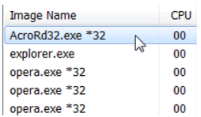
The three central concepts in concurrent programming
Processor
Hardware device that executes machine instructions
Instruction sequence defining potential execution path Passive description of what you would like to happen
Stored on disk/secondary memory
Program
Active system entity executing associate program(s) or; Program in execution on a processor Resides in primary memory, removed on reboot (We’ll assume process, thread, and task are equivalent for now)
Process

Slide 22


Why is a process not a program?
1) Program may be executed by multiple processes at the same time
Wordpad opened twice as separate processes of the same program
1 program, multiple processes
2) Process might run one program, and then another
gcc pre-processor is a different program (executable file) from the compilers syntax analyzer and code generator
The pre-processor, syntax and analyzer, and code generator are executed one after the other by the same process
1 process, multiple programs

Slide 23
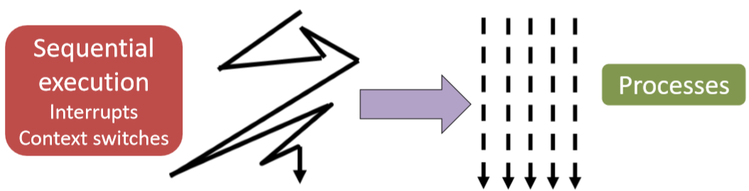
Processes abstract over…
1) Processors
Can have multiple processes regardless number of processors
2) “Disturbed” sequential execution
Interrupt processing: Handling external events (keypresses, clock ticks)
Context switch: Execution jumps to another part of memory

Slide 24

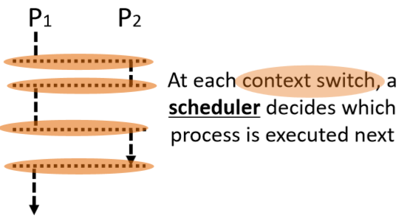
Concurrency vs. Parallelism
Parallel
Multiple (n > 1) processes executing simultaneously.
All executing at a given instant
Concurrent
n > 1 processes are underway simultaneously.
< n may execute at given instant

Slide 25
Difference
– Processes are always concurrent
– …but are not always parallel

Slide 26
Why Use Concurrent Programming?
Multiprocessor machines to make algorithms run faster Implement OS and networking internals
Deal with simultaneously-incoming events (users and network)
Structuring inherently concurrent applications
多处理器机器使算法运行更快实现操作系统和网络内部
处理同时传入的事件(用户和网络)
结构化固有的并发应用程序

Slide 27
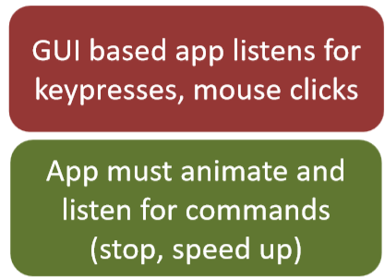
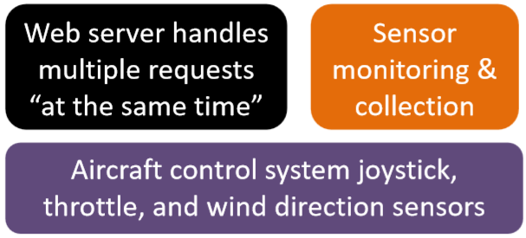
examples

Slide 28
Why is it Important
Doesn’t the scheduler already handle concurrency?
Not really…
Guarantees:
Code will eventually run (no starvation)
Does not guarantee:
Fairness (processes will run the same amount of time)
Timeliness (processes complete in a desirable timeframe)
In concurrency, the scheduler is adversarial
Expect it to do the worst possible thing

Slide 29
Question
Which processes finishes first?
Process 1
Process 2
while(i < 10)
{
i = i + 1;
println(i);
} println(“Process 1 completed.”);
while(i < 10)
{
i = i + 1;
println(i);
} println(“Process 2 completed.”);

Slide 30
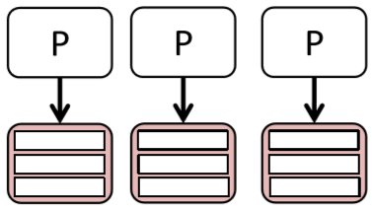
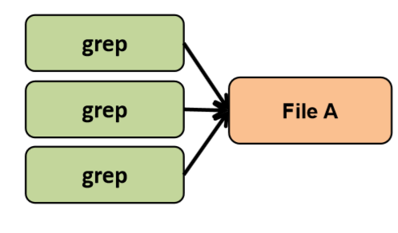
“Safe” Concurrency
When do we not have to worry about concurrency?
1) No shared data or communication
2) Read only data (constant)

Slide 31
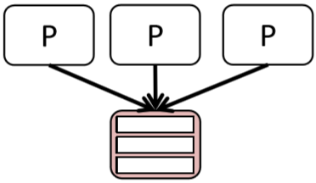
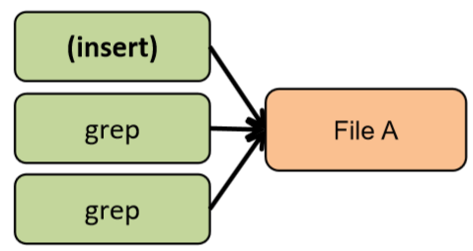
Risky Concurrency
When should we worry about concurrency?
1) Threads access a shared resource without synchronization
2) One or more threads modify the shared resource

Slide 32
Summary
– Concurrency occurs in the physical world
However computers need to be told explicitly what to do…
– Programs, processes and processors are different things
– Concurrency does not equal parallelism
– Processes abstract over processors and disturbed sequential execution
– Concurrent programming is programming with >1 processes
Individual process management (life cycle management)
Real-time systems, database management, transaction processing systems, Operating Systems

Slide 33
Question？

